Slide 1
Deep Dive Into Metrics

Slide 2
When is High Accuracy Bad ?
Not research Worthy
Imbalanced Dataset

Slide 3
Imbalanced Dataset
A dumb Model which predicts ALWAYS dog
Dataset - 99 dog & 1 cat
Dataset - 20 dog & 80 cat .
Calculate the Accuracy now.
The solution ?

Slide 4
Metrics for Supervised Learning
Classification → Accuracy, Recall , precision , F1 - Score.
Regression → MSE, RMSE, MAE, R²

Slide 5
CLASSIFICATION

Slide 6
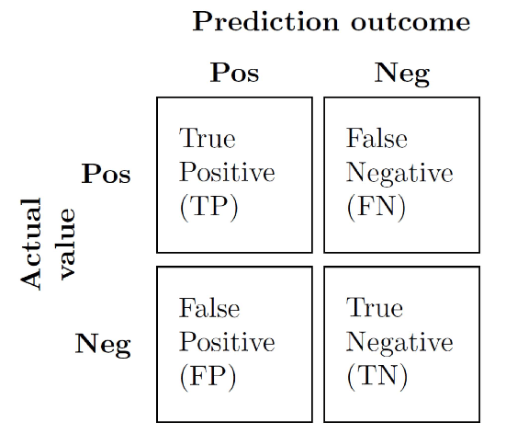
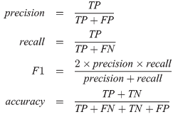
Confusion Matrix

Slide 7
Why F1 - Score (Harmonic Mean) instead of Normal Mean
Recall - 100
Precision - 20
Now Calculate Normal Mean.
Low precision means a bad model, but we our mean does SIGNIFY that. The solution ? Now calculate F1- Score

Slide 8
Recall VS Precision Priority
High Recall = Low False Negative (FN)
High Precision = Low False Positive (FP)

Slide 9
Case 1
Cancer Research :
1 : Cancer (Positive)
0 : Not Cancer (Negative)
What is More Dangerous? Actual Cancer being labelled as Non - Cancer (FN) OR Non - Cancer being labelled as Cancer (FP)
We will prioritize RECALL

Slide 10
Case 2
Spam Mail :
1 : Spam (Positive)
0 : Not Spam (Negative)
What is More Dangerous? Actual Spam being labelled as Non - Spam (FN) OR Non - Spam being labelled as Spam (FP)
We will prioritize Precision

Slide 11
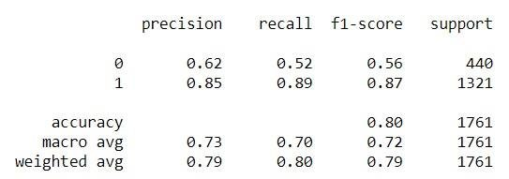
Classification Report of Binary Classification

Slide 12
Why are there multiple values of Recall-Precision ?
From perspective of label 1
1 → 0 (False Negative)
0 → 1 (False Positive)
From perspective of label 0
1 → 0 (False Positive)
0 → 1 (False Negative)

Slide 13
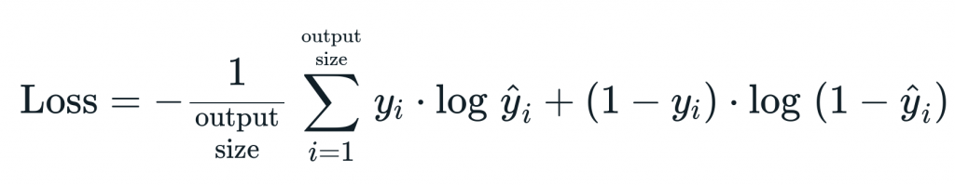
Categorical Cross Entropy Loss

Slide 14
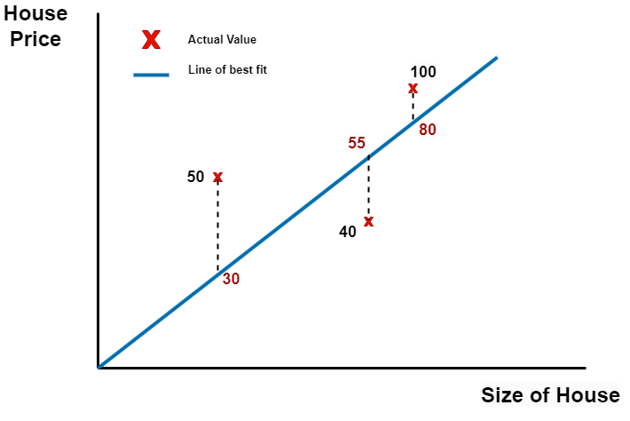
Regression
Task

Slide 15
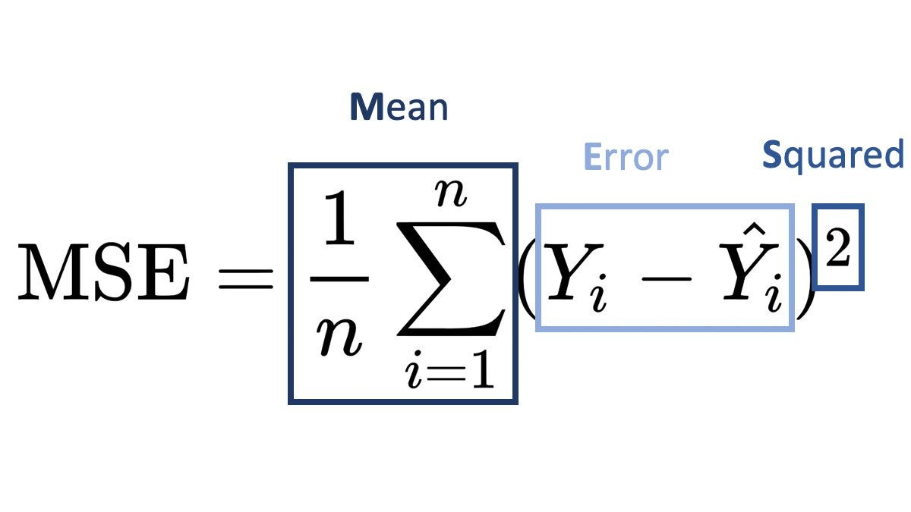
The solution? Mean - Squared Error (MSE)

Slide 16
Calculating MSE
Summation of squared error = (50 - 30) ² + (40 - 55)² + (100 - 80)²
Mean = Summation of squared error / N
What do you think (Root Mean Squared Error) RMSE is?
ANS: Root of MSE

Slide 17
Why square?
Normal error = (50 - 30) + (40 - 55) + (100 - 80)
The (40 - 55) = -15 will decrease the overall value.
ALTERNATIVE Solution : Using Modulus. Mean Absolute error (MAE)

Slide 18
Accuracy vs MSE
Is higher accuracy better?
Is higher MSE better?
Yes
No

